Slide 1

Performance Analysis
CS212: Data Structure

Slide 2
Outline
Performance analysis
By experiment
By analysis
Growth rate of a function
Big O notation

Slide 3
Introduction
We saw two implementations of the ADT List, a linked implementation and an array implementation.
The question that we want to answer now: which implementation gives a better performance?
In general, when having different algorithms that solve the same problem, how to compare their performances? Which one is better?
we need to define what we mean by best.
time complexity—the time it takes to execute
space complexity—the memory it needs to execute.

Slide 4
Introduction
Performance analysis :
The process of measuring the complexity of algorithms
We will concentrate on the time complexity of algorithms,
There are two ways to compare algorithms:
Experimental analysis : compare the running time for different input sizes.
Theoretical analysis : analyze the algorithms independently of the implementation (hardware/software).

Slide 5
Experimental analysis
Most algorithms transform input objects into output objects.
The running time of an algorithm typically grows with the input size.
Average case time is often difficult to determine.
We focus on the worst case running time.
Easier to analyze
Crucial to applications such as games, finance and robotics

Slide 6
Experimental analysis
Write a program implementing the algorithm.
Run the program with inputs of varying size and composition.
Use a method like System.currentTimeMillis()
to get an accurate measure of the actual running time.
Plot the results

Slide 7
Experimental analysis
Limitations:
It is necessary to implement the algorithm, which may be difficult.
Results may not be indicative of the running time on other inputs not included in the experiment.
In order to compare two algorithms, the same hardware and software environments must be used (depends on them).

Slide 8
Theoretical Analysis
Uses a high-level description of the algorithm instead of an implementation.
Characterizes running time as a function of the input size, n.
Takes into account all possible inputs.
Allows us to evaluate the speed of an algorithm independent of the hardware/software environment.

Slide 9
Theoretical Analysis
Pseudocode:
High-level description of an algorithm.
More structured than English prose.
Less detailed than a program.
Preferred notation for describing algorithms.
Hides program design issues.
Example: find max element of an array
Algorithm arrayMax(A, n)
Input array A of n integers
Output maximum element of A
currentMax ← A[0]
for i ← 1 to n − 1 do
if A[i] > currentMax then
currentMax ← A[i]
return currentMax

Slide 10
Theoretical Analysis
Pseudocode Details:
Control flow
if … then … [else …]
while … do …
repeat … until …
for … do …
Indentation replaces braces
Method declaration
Algorithm method (arg [, arg…])
Input …
Output …
Method call
var.method (arg [, arg…])
Return value
return expression
Expressions
Assignment (like = in Java)
Equality testing (like == in Java)
n² Superscripts and other mathematical formatting allowed

Slide 11






Theoretical Analysis
Counting Primitive Operations
Primitive operation corresponds to a low-level instruction with a constant execution time.
Examples: Evaluating an expression, Assigning a value to a variable, Indexing into an array, Calling a method, Returning from a method
Instead of determine the specific execution time of each primitive operation, simply count how many primitive operation are executed.
This operation count will correlate to an actual running time in a specific computer.
By inspecting the pseudocode, we can determine the maximum number of primitive operations executed by an algorithm, as a function of the input size.

Slide 12
Theoretical Analysis
Counting Primitive Operations
 | Statements | Step/Executio | Freq. | Total
1 | Algorithm Sum1(a[],n)
2 | {
3 | S = 0.0;
4 | for i=1 to n do
5 | s = s+a[i];
6 | return s;
7 | }

Slide 13
Theoretical Analysis
Counting Primitive Operations
 | Statements | S/E | Freq. | Total
1 | Algorithm Sum1(a[],n) | 0 | - | 0
2 | { | 0 | - | 0
3 | S = 0.0; | 1 | 1 | 1
4 | for i=1 to n do | 1 | n+1 | n+1
5 | s = s+a[i]; | 1 | n | n
6 | return s; | 1 | 1 | 1
7 | } | 0 | - | 0
n+1
n
2n+3

Slide 14
Theoretical Analysis
Counting Primitive Operations
 | Statements | S/E | Freq. | Total
1 | Algorithm Sum2(a[],n,m)
2 | {
3 | for i=1 to n do;
4 | for j=1 to m do
5 | s = s+a[i][j];
6 | return s;
7 | }

Slide 15
Theoretical Analysis
Counting Primitive Operations
 | Statements | S/E | Freq. | Total
1 | Algorithm Sum2(a[],n,m) | 0 | - | 0
2 | { | 0 | - | 0
3 | for i=1 to n do | 1 | n+1 | n+1
4 | for j=1 to m do | 1 | n(m+1) | n(m+1)
5 | s = s+a[i][j]; | 1 | nm | nm
6 | return s; | 1 | 1 | 1
7 | } | 0 | - | 0
n+1
m+1
n
m
2nm+2n+2

Slide 16

Estimating Running Time
Algorithm Sum1 executes 2n + 3 primitive operations in the worst case.
Define:
a = Time taken by the fastest primitive operation
b = Time taken by the slowest primitive operation
Let T(n) be worst-case time of Sum1. Then a (2n + 3) ≤ T(n) ≤ b(2n + 3)
Hence, the running time T(n) is bounded by two linear functions.

Slide 17
Growth Rate of Running Time
Changing the hardware/ software environment
Affects T(n) by a constant factor, but
Does not alter the growth rate of T(n)
The linear growth rate of the running time T(n) is an intrinsic property of algorithm Sum1.

Slide 18
Why Growth Rate Matters
if runtime is... | time for n + 1 | time for 2 n | time for 4 n
c log n | c log (n + 1) | c (log n + 1) | c(log n + 2)
c n | c (n + 1) | 2c n | 4c n
c n log n | ~ c n log n + c n | 2c n log n + 2cn | 4c n log n + 4cn
c n² | ~ c n² + 2c n | 4c n² | 16c n²
c n³ | ~ c n³ + 3c n² | 8c n³ | 64c n³
c 2^{n} | c 2 ^{n+1} | c 2 ^{2n} | c 2 ^{4n}
runtime
quadruples
when problem
size doubles

Slide 19









Comparing Growth Rate in Tabular form

Slide 20
Comparing Growth Rate in Tabular form

Slide 21
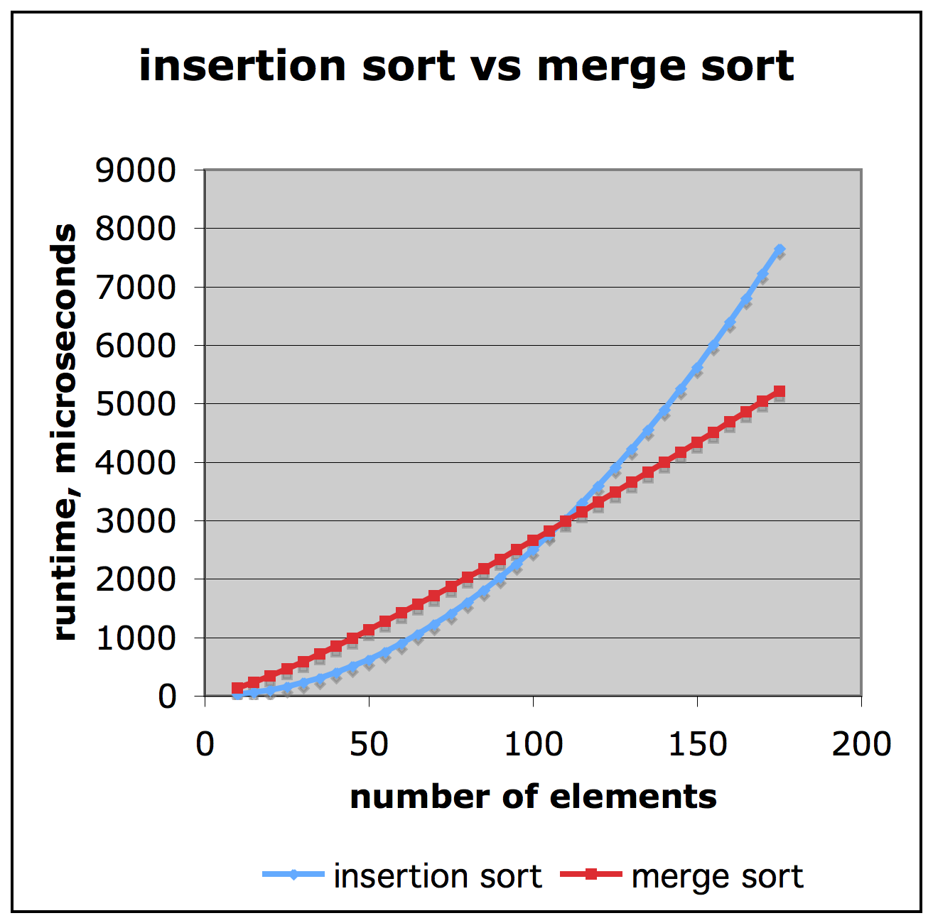






Comparison of Two Algorithms (an example)
insertion sort is
n² / 4
merge sort is
2 n log n
sort a million items using a basic PC?
insertion sort takes
roughly 70 hours
while
merge sort takes
roughly 40 seconds

Slide 22

Constant Factors
The growth rate is not affected by
constant factors or
lower-order terms
Examples
10²n + 10⁵ is a linear function
10⁵n² + 10⁸n is a quadratic function

Slide 23
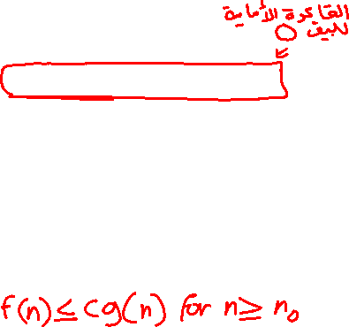
Big-Oh Notation
Given functions f(n) and g(n), we say that f(n) is O(g(n)) if there are positive constants c and n₀ such that
f(n) ≤ cg(n) for n ≥ n₀
Example: 2n + 10 is O(n)
2n + 10 ≤ cn
10 ≤ cn – 2n
10 ≤ (c − 2) n
10/(c − 2) ≤ n
Pick c = 3 and n₀ = 10

Slide 24
Big-Oh Notation
Given functions f(n) and g(n), we say that f(n) is O(g(n)) if there are positive constants c and n₀ such that
f(n) ≤ cg(n) for n ≥ n₀
Example: 2n + 10 is O(n)
2n + 10 ≤ cn
10 ≤ cn – 2n
10 ≤ (c − 2) n
10/(c − 2) ≤ n
Pick c = 3 and n₀ = 10
2n + 10 ≤ 2n + 10n = 12n
n₀ = 1
c = 12

Slide 25
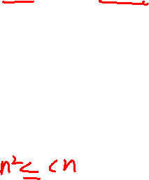
Big-Oh Example
Example: the function n² is not O(n)
n² ≤ cn
n ≤ c
The above inequality cannot be satisfied since c must be a constant

Slide 26

More Big-Oh Examples
7n-2
7n-2 is O(n)
need c > 0 and n₀ ≥ 1 such that 7n-2 ≤ cn for n ≥ n₀
this is true for c = 7 and n₀ = 1
3n³ + 20n² + 5
3n³ + 20n² + 5 is O(n³)
need c > 0 and n₀ ≥ 1 such that 3n³ + 20n² + 5 ≤ cn³ for n ≥ n₀
this is true for c = 4 and n₀ = 21
3 log n + 5
3 log n + 5 is O(log n)
need c > 0 and n₀ ≥ 1 such that 3 log n + 5 ≤ clog n for n ≥ n₀
this is true for c = 8 and n₀ = 2

Slide 27
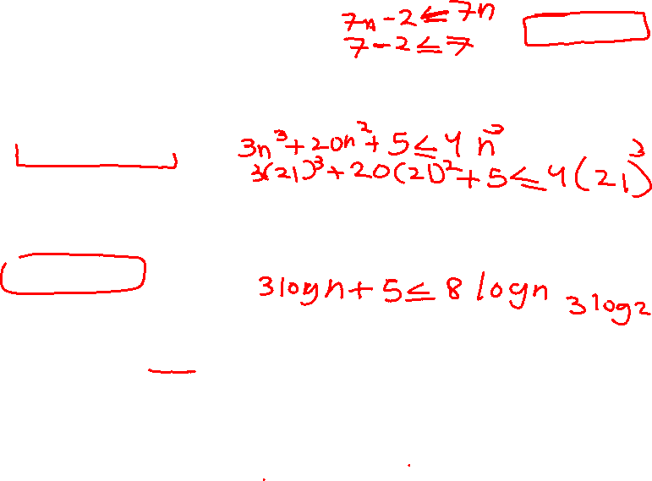
More Big-Oh Examples
7n-2
7n-2 is O(n)
need c > 0 and n₀ ≥ 1 such that 7n-2 ≤ cn for n ≥ n₀
this is true for c = 7 and n₀ = 1
3n³ + 20n² + 5
3n³ + 20n² + 5 is O(n³)
need c > 0 and n₀ ≥ 1 such that 3n³ + 20n² + 5 ≤ cn³ for n ≥ n₀
this is true for c = 4 and n₀ = 21
3 log n + 5
3 log n + 5 is O(log n)
need c > 0 and n₀ ≥ 1 such that 3 log n + 5 ≤ clog n for n ≥ n₀
this is true for c = 8 and n₀ = 2
7n - 2 ≤ 7n
n₀ = 1 c = 7

Slide 28
More Big-Oh Examples
7n-2
7n-2 is O(n)
need c > 0 and n₀ ≥ 1 such that 7n-2 ≤ cn for n ≥ n₀
this is true for c = 7 and n₀ = 1
3n³ + 20n² + 5
3n³ + 20n² + 5 is O(n³)
need c > 0 and n₀ ≥ 1 such that 3n³ + 20n² + 5 ≤ cn³ for n ≥ n₀
this is true for c = 4 and n₀ = 21
3 log n + 5
3 log n + 5 is O(log n)
need c > 0 and n₀ ≥ 1 such that 3 log n + 5 ≤ clog n for n ≥ n₀
this is true for c = 8 and n₀ = 2
3n³ + 20n² + 5 ≤ 3n³ + 20n³ + 5n³ = 28n³
n₀ = 1
c = 28

Slide 29
More Big-Oh Examples
7n-2
7n-2 is O(n)
need c > 0 and n₀ ≥ 1 such that 7n-2 ≤ cn for n ≥ n₀
this is true for c = 7 and n₀ = 1
3n³ + 20n² + 5
3n³ + 20n² + 5 is O(n³)
need c > 0 and n₀ ≥ 1 such that 3n³ + 20n² + 5 ≤ cn³ for n ≥ n₀
this is true for c = 4 and n₀ = 21
3 log n + 5
3 log n + 5 is O(log n)
need c > 0 and n₀ ≥ 1 such that 3 log n + 5 ≤ clog n for n ≥ n₀
this is true for c = 8 and n₀ = 2
3 log n + 5 ≤ 3 log n + 5 log n = 8 log n
n₀ = 2
c = 8

Slide 30
Big-Oh and Growth Rate
The big-Oh notation gives an upper bound on the growth rate of a function.
The statement “f(n) is O(g(n))” means that the growth rate of f(n) is no more than the growth rate of g(n).
We can use the big-Oh notation to rank functions according to their growth rate.

Slide 31
Big-Oh Rules
If f(n) is a polynomial of degree d, then f(n) is O(n^{d}), i.e.,
Drop lower-order terms
Drop constant factors
Use the smallest possible class of functions
Say “2n is O(n)” instead of “2n is O(n²)”.
Use the simplest expression of the class
Say “3n + 5 is O(n)” instead of “3n + 5 is O(3n)”

Slide 32
Asymptotic Algorithm Analysis
The asymptotic analysis of an algorithm determines the running time in big-Oh notation.
To perform the asymptotic analysis
We find the worst-case number of primitive operations executed as a function of the input size.
We express this function with big-Oh notation.
Example:
We determine that algorithm Sum1 executes at most 2n + 3 primitive operations
We say that algorithm Sum1 “runs in O(n) time”
Since constant factors and lower-order terms are eventually dropped anyhow, we can disregard them when counting primitive operations

Slide 33
Computing Prefix Averages (an example)
We further illustrate asymptotic analysis with two algorithms for prefix averages.
The i-th prefix average of an array X is average of the first (i + 1) elements of X:
A[i] = (X[0] + X[1] + … + X[i])/(i+1)
Computing the array A of prefix averages of another array X has applications to financial analysis

Slide 34
Computing Prefix Averages (an example)
The following algorithm computes prefix averages in quadratic time.
 | Statements | S/E | Freq. | Total
1 | Algorithm prefixAverages1(X, n) | 0 | - | 0
2 | { | 0 | - | 0
3 | A ← new array of n integers | 1 | n | n
4 | for i ← 0 to n − 1 do | 1 | n+1 | n+1
5 | s ← X[0] | 1 | n | n
6 | for j ← 1 to i do | 1 | 1+2+3+… (n) | n(n+1)/2
7 | s ← s + X[j] | 1 | 1+2+3+… (n-1) | n(n-1)/2
8 | A[i] ← s / (i + 1) | 1 | n | n
9 | return A | 1 | 1 | 1
10 | } | 0 | - | 0
 |  |  |  | n²+4n+2
Thus, Algorithm prefixAverages1 is O(n²).

Slide 35


Computing Prefix Averages (an example)
The following algorithm computes prefix averages in quadratic time.
 | Statements | S/E | Freq. | Total
1 | Algorithm prefixAverages1(X, n) | 0 | - | 0
2 | { | 0 | - | 0
3 | A ← new array of n integers | 1 | n | n
4 | for i ← 0 to n − 1 do | 1 | n+1 | n+1
5 | s ← X[0] | 1 | n | n
6 | for j ← 1 to i do | 1 | 1+2+3+… (n) | n(n+1)/2
7 | s ← s + X[j] | 1 | 1+2+3+… (n-1) | n(n-1)/2
8 | A[i] ← s / (i + 1) | 1 | n | n
9 | return A | 1 | 1 | 1
10 | } | 0 | - | 0
 |  |  |  | n²+4n+2
n
Thus, Algorithm prefixAverages1 is O(n²).
Notes:
Line 6 : 1+2+3+… (n-1)+n → n(n+1)/2
Line 7 : 1+2+3+… (n-1) → n(n-1)/2
Total number is n^2+4n+2

Slide 36
Computing Prefix Averages (an example)
The following algorithm computes prefix averages in linear time by keeping a running sum.
 | Statements | S/E | Freq. | Total
1 | Algorithm prefixAverages2(X, n) | 0 | - | 0
2 | { | 0 | - | 0
3 | A ← new array of n integers | 1 | n | n
4 | s ← 0 | 1 | 1 | 1
5 | for i ← 0 to n − 1 do | 1 | n+1 | n+1
6 | s ← s + X[i] | 1 | n | n
7 | A[i] ← s / (i + 1) | 1 | n | n
8 | return A | 1 | 1 | 1
9 | } | 0 | - | 0
 |  |  |  | 4n+3
Thus, Algorithm prefixAverages2 is O(n).

Slide 37
Computing Prefix Averages (an example)
The following algorithm computes prefix averages in linear time by keeping a running sum.
 | Statements | S/E | Freq. | Total
1 | Algorithm prefixAverages2(X, n) | 0 | - | 0
2 | { | 0 | - | 0
3 | A ← new array of n integers | 1 | n | n
4 | s ← 0 | 1 | 1 | 1
5 | for i ← 0 to n − 1 do | 1 | n+1 | n+1
6 | s ← s + X[i] | 1 | n | n
7 | A[i] ← s / (i + 1) | 1 | n | n
8 | return A | 1 | 1 | 1
9 | } | 0 | - | 0
 |  |  |  | 4n+3
n
Thus, Algorithm prefixAverages2 is O(n).

Slide 38
Big-Oh From Smallest to Largest
O(1) | Constant
O(log n) | Logarithmic
O(n) | Linear
O(n log n) | n log n
O(n^{c}) O(n²), O(n³), O(n¹⁶), etc | Polynomial
O(c^{n}) O(1.6^{n}), O(2^{n}), O(3^{n}), etc | Exponential
O(n!) | Factorial
O(n^{n}) | n power n

Slide 39
Big-Oh Examples
O(1) | Push, Pop, Enqueue (if there is a tail reference), Dequeue, Accessing an array element
O(log n) | Binary search
O(n) | Linear search
O(n log n) | Heap sort, Quick sort (average), Merge sort
O(n²) | Selection sort, Insertion sort, Bubble sort
O(n³) | Matrix multiplication
O(2^{n}) | Towers of Hanoi
O(n!) | All permutation of N elements
O(n^{n}) | ….

Slide 40
Revision
Each countable step is weighted as 1, anything else is weighted 0 (S/E)
Count the time each step is executed. This can be (1) time, constant time (5, 10, 21,…) or variable time (n, m, n+1, n²,…) (Freq)
Multiply (S/E) by (Freq) to get (Total)
Having done all the above for each step, sum (Total) for each step together to get the complexity

Slide 41
Revision
for/while/do-while are examples where there are repetition/frequency.
for/while, <, ++ loops
Freq = max – initial
for/while, <=, ++ loops
Freq = max – initial + 1
for/while, >, -- loops
Freq = initial – max
for/while, >=, -- loops
Freq = initial – max + 1
IMPORTANT: for/while checking step/line should add +1 (for last check). Internal loop steps use the above formulas.

Slide 42
Revision
do-while, <, ++ loops
Freq = 1+ max – initial
do-while, <=, ++ loops
Freq = 1 + max – initial + 1
do-while, >, -- loops
Freq = 1+ initial – max
do-while, >=, -- loops
Freq = 1 + initial – max + 1
IMPORTANT: both do-while checking step/line and internal loop steps use the above formulas.

Slide 43
Revision
In other word:
++
max – initial
--
initial – max
<=, >=
add (+1)
If, do-while
add (+1), for both checking and internal steps
Else (for/while)
add (+1) for checking step only.
IMPORTANT: This only apply for incrementing/decrementing loops with simple checking (<,>,<=,>=). These are generalization (there are many exceptions)

Slide 44
Revision
One exception example:
for (int i = 0; i < n; i++) for(int j = 0; j < i; j++)
System.out.println(j)
In this case, the internal loop depends on the external loop (j < i). Therefore, the number of loops is changing each time.
The checking line will be executed 1+2+3+…+n
The println will be executed 0+1+2+…+(n-1)
This is an example/approximation for
Such cases require careful counting

Slide 45
Revision
Big-Oh for a function f(n)
Drop lower-order terms
Drop constant factors
Use the smallest possible class
Use the simplest expression of the class
Or, Find highest order term, and drop everything else (including constants)

Slide 46
Revision
Proving f(n) is O(g(n))
f(n) is O(g(n)) if there are positive constants c and n₀ such that: f(n) ≤ cg(n) for n ≥ n₀
Or:
Drop negative terms
Upgrade lower-order terms to the same level of the highest-order term level
Work it from there to calculate c and n₀

Slide 47
Excercises
a).
s = 0;
for (i = 1; i < n-1; i++)
s = s + 1;
b).
s = 0;
for (i = n-5; i > 4; i--)
s = s + i;

Slide 48
Excercises
a).
s = 0; 1
for (i = 1; i < n-1; i++) n-1
s = s + 1; n-2
Total: 2n-2 O(n)
b).
s = 0;
for (i = n-5; i > 4; i--)
s = s + i;

Slide 49
Excercises
a).
s = 0; 1
for (i = 1; i < n-1; i++) n-1
s = s + 1; n-2
Total: 2n-2 O(n)
b).
s = 0; 1
for (i = n-5; i > 4; i--) n-8
s = s + i; n-9
Total: 2n-16 O(n)

Slide 50
Excercises
c).
s = 0;
for (i = 1; i <= n; i++)
for (j = 1; j <= n; j++)
s = s + 1;
d).
i = 0;
while (i <= 10)
i = i + 1;

Slide 51
Excercises
c).
s = 0; 1
for (i = 1; i <= n; i++) n+1
for (j = 1; j <= n; j++) n(n+1)
s = s + 1; n²
Total: 2n²+2n+2 O(n²)
d).
i = 0;
while (i <= 10)
i = i + 1;

Slide 52
Excercises
c).
s = 0; 1
for (i = 1; i <= n; i++) n+1
for (j = 1; j <= n; j++) n(n+1)
s = s + 1; n²
Total: 2n²+2n+2 O(n²)
d).
i = 0; 1
while (i <= 10) 12
i = i + 1; 11
Total: 24 O(1)

Slide 53
Excercises
e).
s = 0;
for (i = 1; i <= n; i++)
for (j = 0; j <= n; j++)
for (k = 0; k <= n; k++)
s = s + 1;

Slide 54
Excercises
e).
s = 0; 1
for (i = 1; i <= n; i++) n+1
for (j = 0; j <= n; j++) n(n+2)
for (k = 0; k <= n; k++) n(n+1)(n+2)
s = s + 1; n(n+1)(n+1)
Total: O(n³)

Slide 55
Excercises
f).
s = 0;
for (i = 0; i <= n; i++)
for (j = 0; j < i; j++)
s = s + 1;
g).
s = 0;
for (i = 0; i <= n; i++)
for (j = i+1; j <= n; j++)
s = s + 1;

Slide 56
Excercises
f).
s = 0; 1
for (i = 0; i <= n; i++) n+2
for (j = 0; j < i; j++) 1+2+...+(n+1) ~n(n+1)/2
s = s + 1; 1+2+...+n =n(n+1)/2
Total: O(n²)
g).
s = 0;
for (i = 0; i <= n; i++)
for (j = i+1; j <= n; j++)
s = s + 1;

Slide 57
Excercises
f).
s = 0; 1
for (i = 0; i <= n; i++) n+2
for (j = 0; j < i; j++) 1+2+...+(n+1) ~n(n+1)/2
s = s + 1; 1+2+...+n =n(n+1)/2
Total: O(n²)
g).
s = 0; 1
for (i = 0; i <= n; i++) n+2
for (j = i+1; j <= n; j++) (n+1)+n+...+2+1 ~n(n+1)/2
s = s + 1; n+(n-1)+...+2+1 =n(n+1)/2
Total: O(n²)

